Slide 1
DAB Picasso
The latest masterpiece from DAB.IO

Slide 2
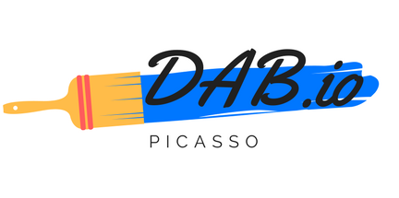
DAB.Io Partners
Didier Krux
Andrew Law
Brad Wong

Slide 3

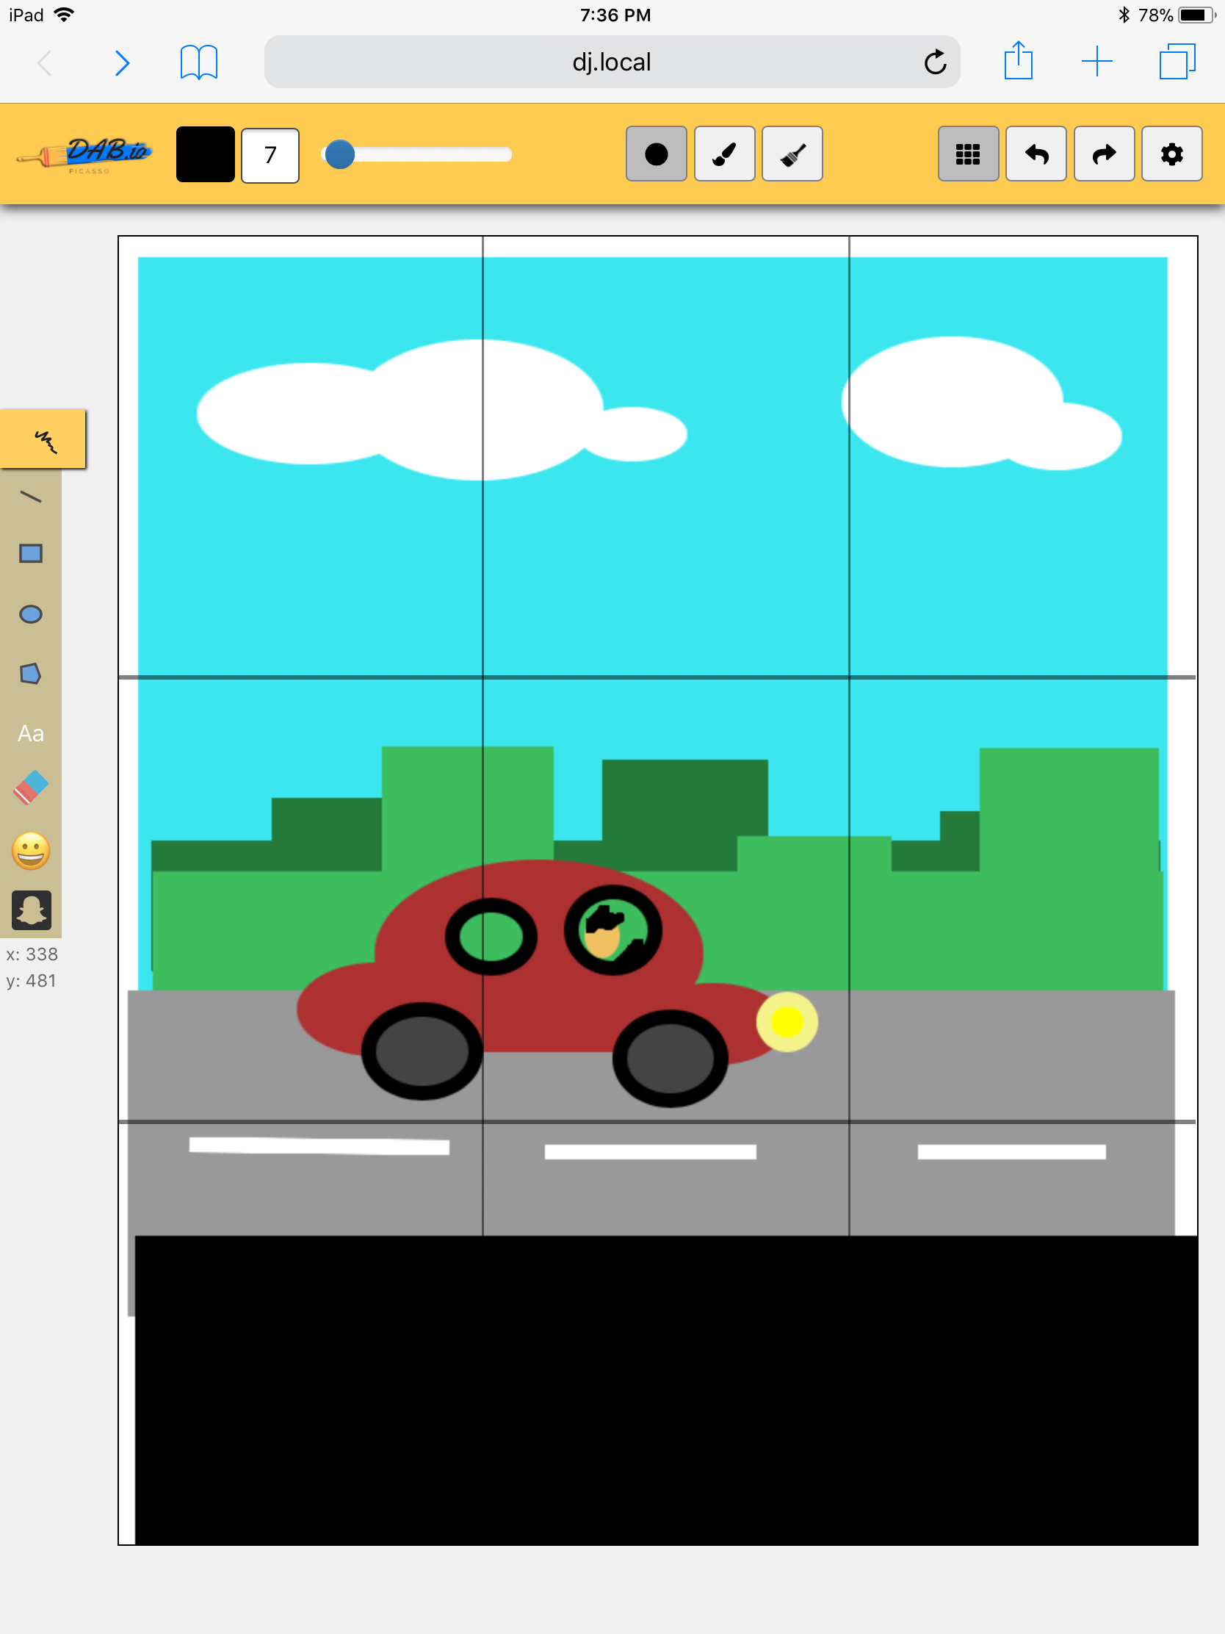
dab Picasso
Modern HTML5 paint application
It just works – on iPad, on mobile
Interface designed by artists for artists
Effortless. Magical.

Slide 4
Key Features
Full mobile support (implementation of Hammer.js)
Image import/export
Dynamic circle/square
Keyboard shortcuts
Beautiful brushes
Google Fonts API integration
Custom canvas size
Emoji stickers

Slide 5
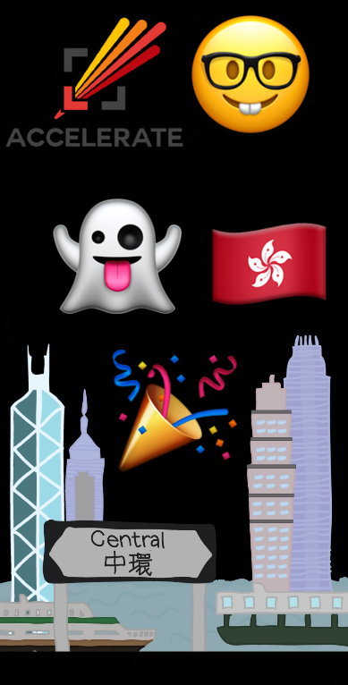
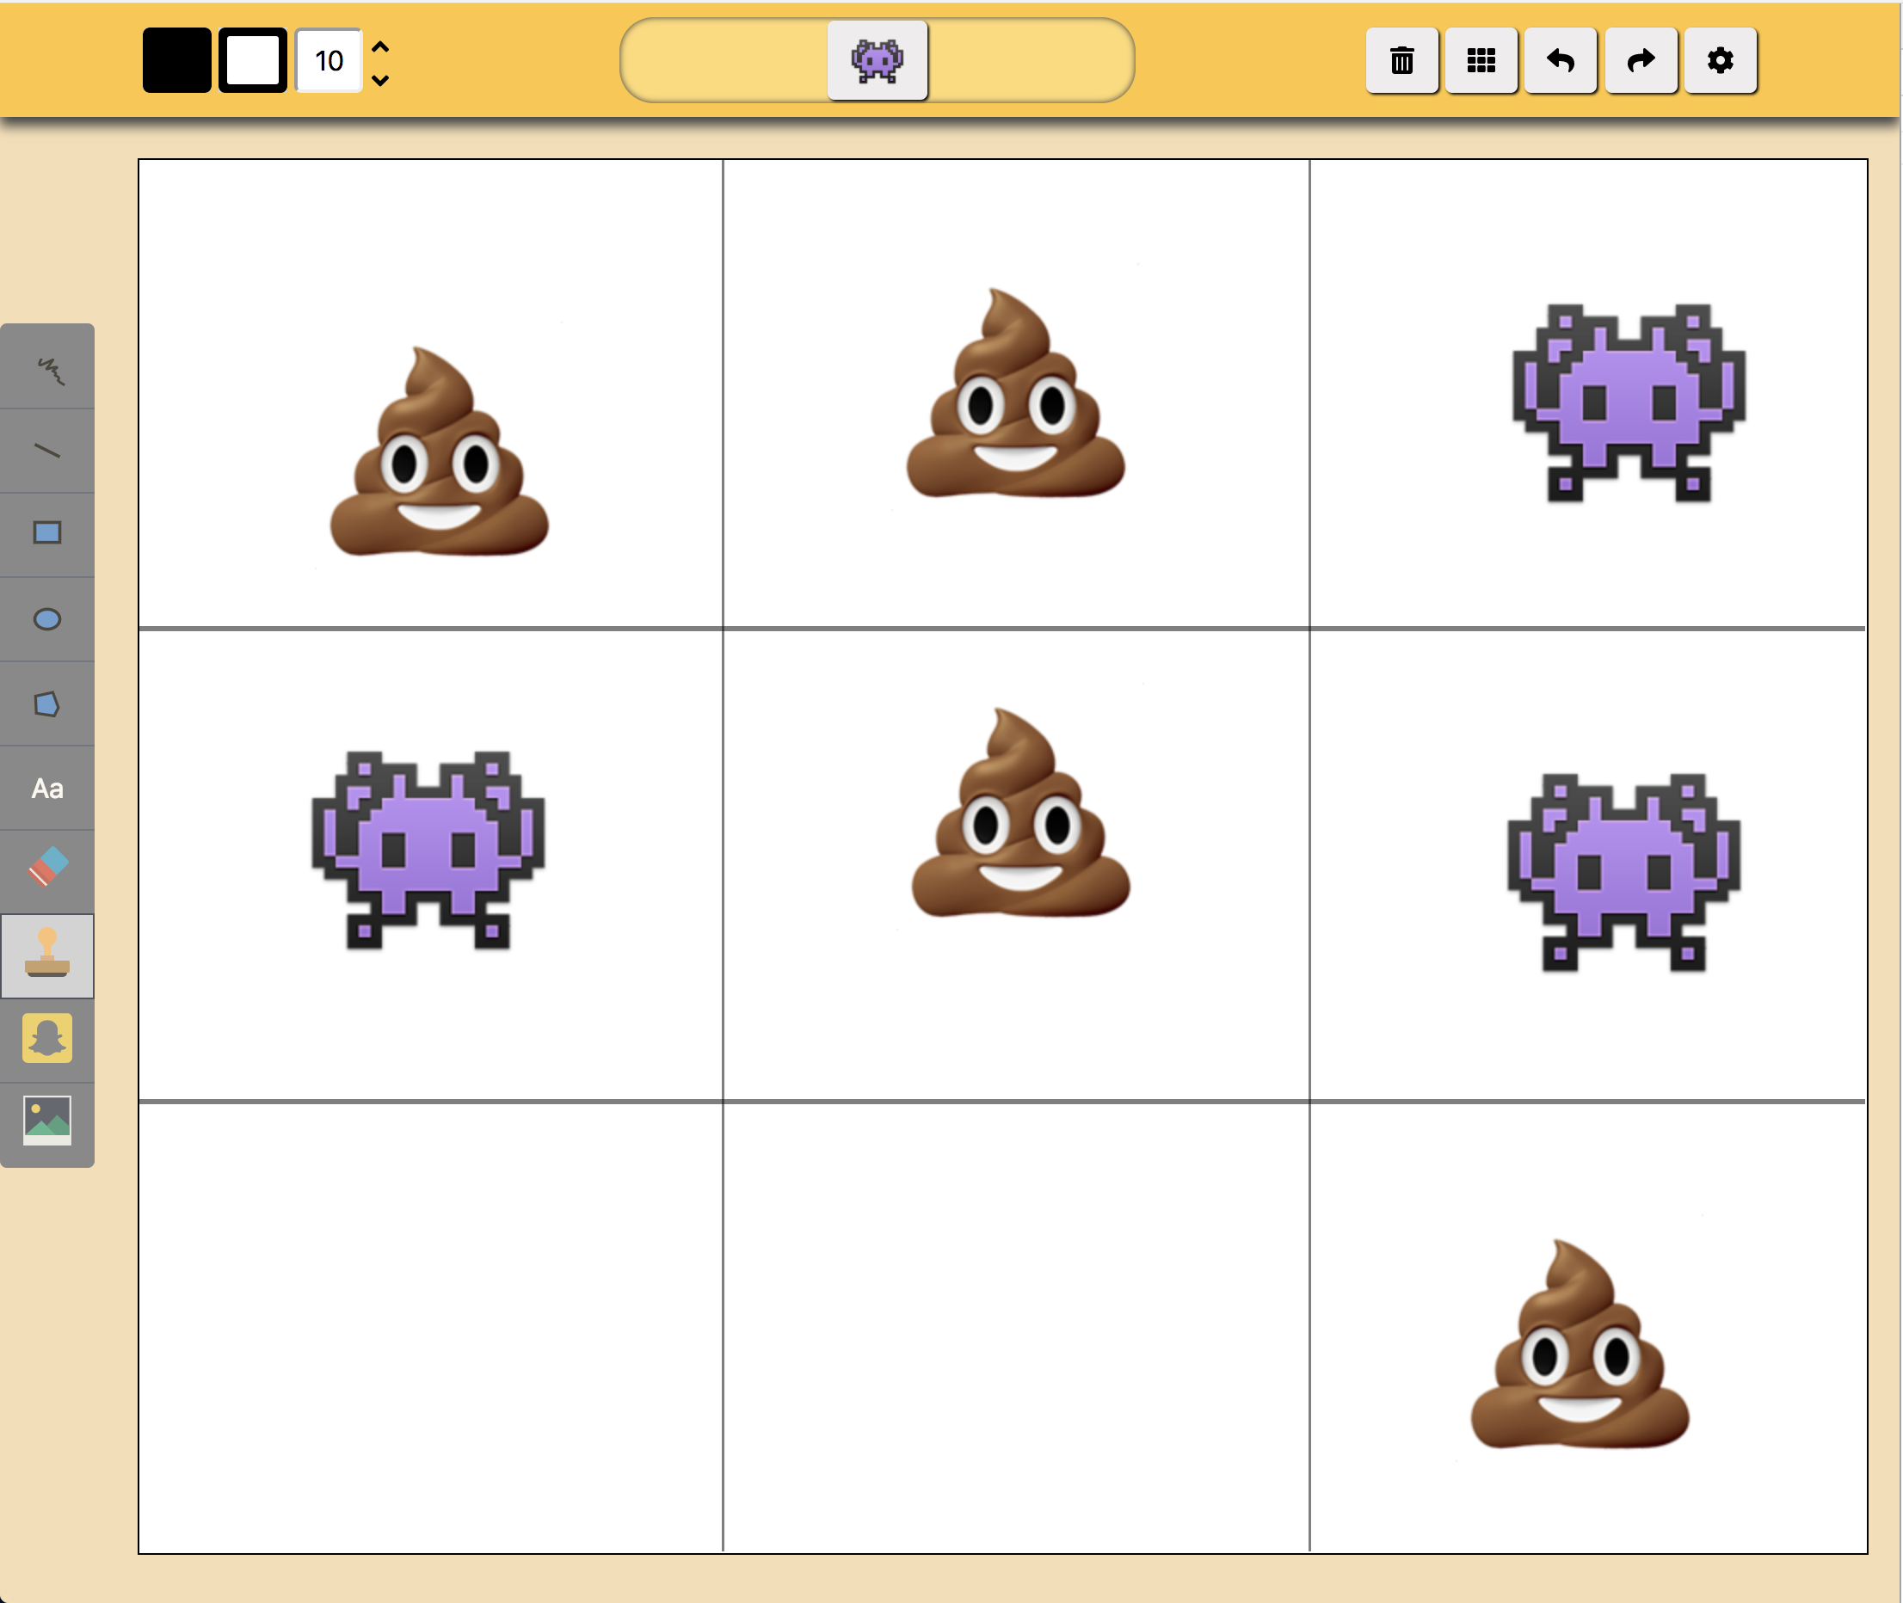

Examples

Slide 6
Picture Time!

Slide 7
Project management
Didier
Andrew
Brad
Mobile Implementation
Stickers
Filters
Stroke/Fill Properties
Shortcuts
Core Functionality
Shapes
Text
Mobile User Interface
User Interface
Brushes
Button Functionality
Graphics

Slide 8
Demonstration

Slide 9
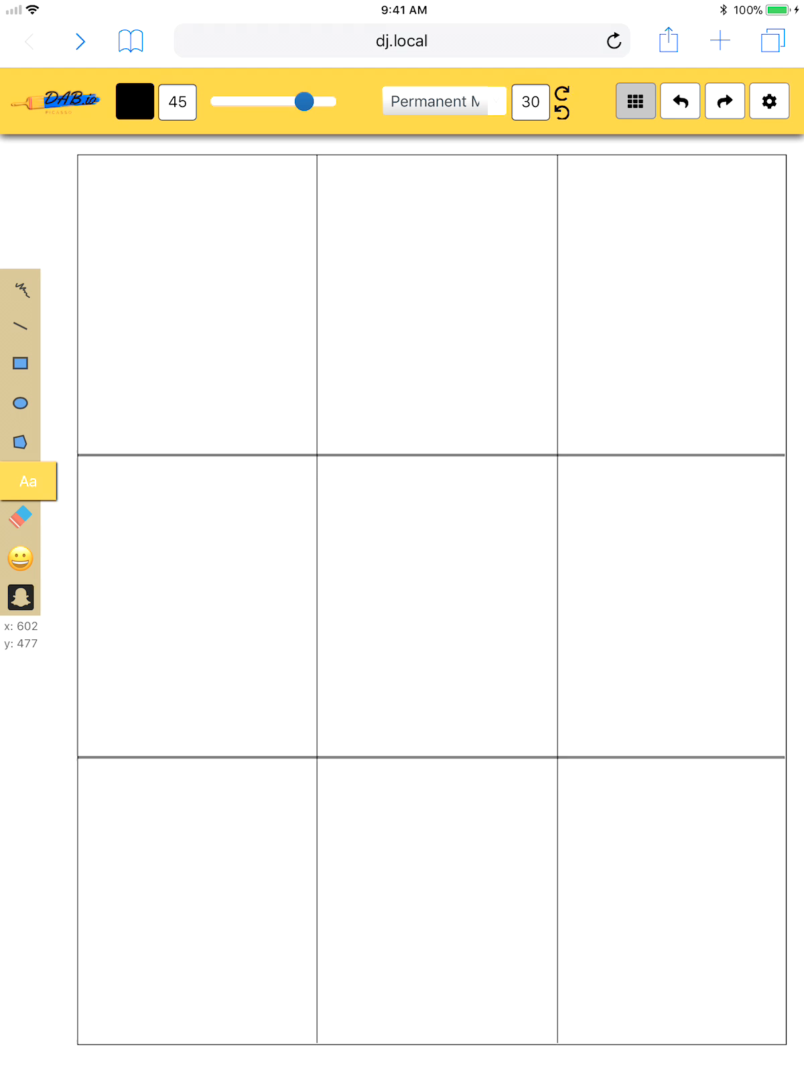
Pika PIka
Live replay of drawing!

Slide 10
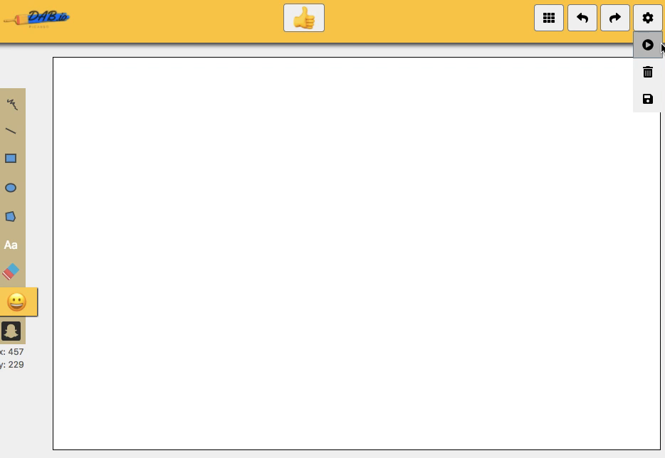
Unleash your inner picasso

Slide 11
Q&A

